Slide 1


Slide 2
Git Overview
What is git?
Install git
How does git work?
Setting up Git
Basic git operations
Branching
Merging
Working with Remote Repositories.

Slide 3

What is Git ?
Started in 2005
Created by Linus Torvald to aid in Linux kernel development
Git is a version-control system for tracking changes in computer files and coordinating work on those files among multiple people.
It is primarily used for source-code management in software development, but it can be used to keep track of changes in any set of files.

Slide 4
What is Git …. ?
Git is a free and open source distributed version control system (VCS)
A version control system, or VCS, tracks the history of changes as people and teams collaborate on projects together.
DVCSs allow full access to every file, branch, and iteration of a project, and allows every user access to a full and self-contained history of all changes.
DVCS: Users keep entire code and history on their location machines

Slide 5
Why Git?
According to the latest Stack Overflow developer survey, more than 70 percent of developers use Git, making it the most-used VCS in the world.
Git allows Developers to find out:-
Which changes were made?
Who made the changes?
When were the changes made?
Why were changes needed?

Slide 6
Other Popular Version Control Systems
Subversion(SVN)
Perforce
Mercurial
Bazaar

Slide 7
Installing Git
• Linux (Debian)
Command: sudo apt-get install git!
• Mac
http://git-scm.com/download/mac
• Windows
http://git-scm.com/download/win

Slide 8
Git initial Setup
Your Identity
Your Code Editor
Check Your Setting
$ git config --global user.name “Ali Abdi"
$ git config --global user.email aliabdi@example.com
$ git config --global core.editor vscode
$ git config --list //displays all setting
$ git config user.name // displays username

Slide 9
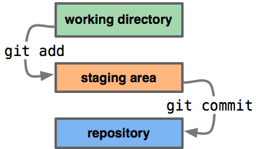
basic Git Workflow.
Step 1 : You modify a file from the working directory. Modified
Step 2 : You add these files to the staging area or index. Staged
Step 3 : repository or repo: You perform commit operation that moves the files from the staging area. Committed

Slide 10
1. create a new local repository:
# git init
It creates a .git directory that contains all the Git-related information for your project.
Create new file file1.txt and file2.txt in repo directory and run following command to check status.
Git Status command displays a list the files you’ve changed and those you still need to add or commit.
# git status

Slide 11
The Status of a File: Git Status
In general, files can have one of two statuses in Git:
untracked: a file that is not under version control, yet, is called "untracked".
This means that the version control system doesn't watch for (or "track") changes to this file. In most cases, these are either files that are newly created or files that are ignored
tracked: all files that are already under version control are called "tracked".
Git watches these files for changes and allows you to commit or discard them.

Slide 12
Making Your First Commit
it's time to make our initial commit for this project.
$ git add -A
$ git commit -m "Initial commit"

Slide 13
Inspecting the Commit History
The "git log" command is used to display the project's commit history:
It lists the commits in chronological order, beginning with the newest item.
Every commit item consists (amongst other things) of the following metadata:
Commit Hash
Author Name & Email
Date
Commit Message
The Commit Hash: Every commit has a unique identifier: a 40-character checksum called the "commit hash".

Slide 14
Ignoring Files
The list of files to ignore is kept in a simple file called ".gitignore“
The .gitignore file should in the root folder of your project.
Create an empty file in your favorite editor and save it as ".gitignore" in your project's root folder.
Ignore all files of a certain type
*.txt
*.pdf
Ignore all files in a certain folder:
Path/folder/*

Slide 15
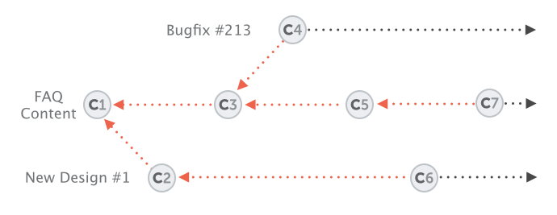
Git Branching
A branch represents an independent line of development.
You can think of them as a way to request a brand new working directory, staging area, and project history.
Branching is one of Git’s most powerful features

Slide 16
Git Branching
The ‘git branch’ command lets you create, list, rename, and delete branches.
Creating New Branch
Git branch NewBranch
Check Branches
Git branch
Delete Branch
Git branch –D newBranch
Switch to new Branch
Git checkout branch
Note: Default Branch is called Master Branch

Slide 17
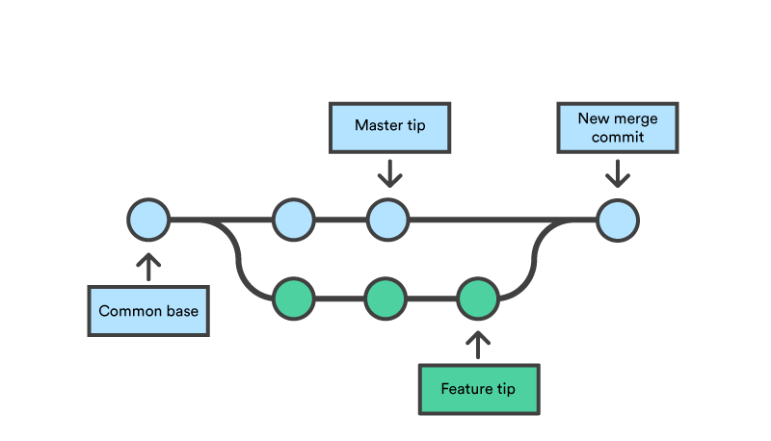
Merging Branches (Changes)
Check out the branch that should receive the changes.
Call the "git merge" command with the name of the branch that contains the desired changes.
Let's integrate the changes from our “newBranch" branch into "master":
$ git checkout master
$ git merge contact-form

Slide 18
Undoing Things
One of the greatest aspects about Git is that you can undo almost anything.
In the end, this means that you actually can't mess up:
Fixing the Last Commit: correct the commit message,
$ git commit --amend -m "This is the correct message"

Slide 19
Undoing things
In case you want to add some more changes to that last commit, you can simply stage them as normal and then commit again:
$ git add somefiles
$ git commit --amend -m "commit message“
--amend command can only be used to fix the very last commit. Older commits can't be modified with "amend".

Slide 20
Undoing Local Changes (uncommited)
Changes are called "local" when they haven't been committed
To restore a file to its last committed version, you use the "git checkout" command:
$ git checkout HEAD file/to/restore.ext
If you need to discard all current changes in your working copy and want to restore the last committed version of your complete project, the "git reset" command is your friend:
$ git reset --hard HEAD

Slide 21
Undoing Committed Changes
Sometimes you'll want to undo a certain commit. E.g. when you notice that your changes were wrong,
Using the "git revert" command is one possibility to undo a previous commit.
Simply provide the hash of the commit you want to revert:
$ git revert 2b504be

Slide 22
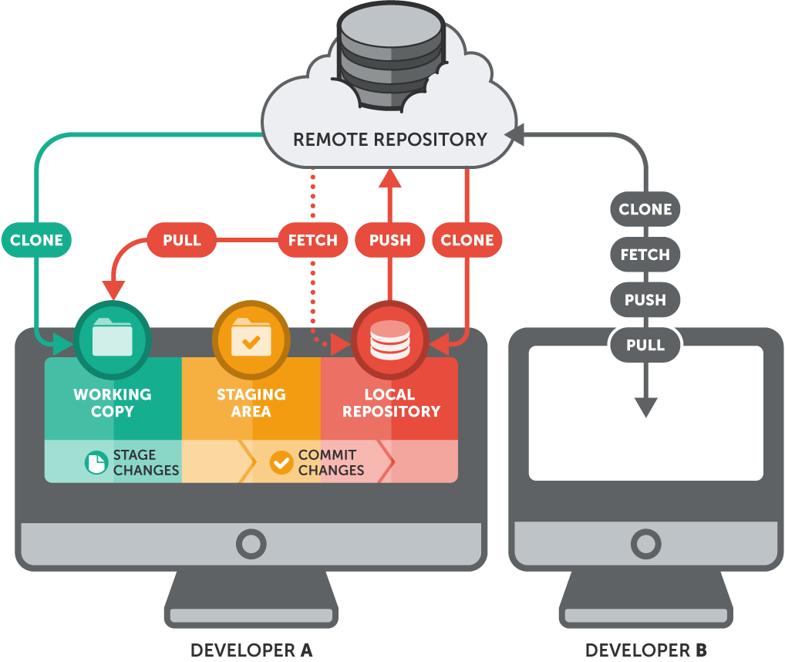
Remote Repositories

Slide 23
Connecting a Remote Repository
git remote add origin https://github.com/repo/git-remote.git
Check remote repo
Git remote –v
To download remote changes use “git pull” command
To upload local changes use “git push” command

Slide 24

GitHub Overview
What is GitHub?
Creating GitHub Account
Creating Repository
Branching and Merging
Pull Requests

Slide 25
What is GitHub ?
GitHub is a code hosting platform for version control and collaboration.
It lets you and others work together on projects from anywhere.
https://www.github.com

Slide 26
Step 1. Create a Repository
A repository (Directory) is usually used to organize a single project.
Repositories can contain folders and files, images, videos, spreadsheets, and data sets – anything your project needs

Slide 27
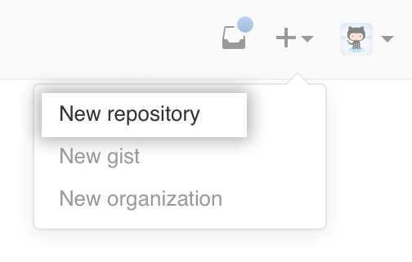
To create a new repository
In the upper right corner, next to your avatar or icon, click and then select New repository.
Name your repository hello-world.
Write a short description.
Select Initialize this repository with a README.

Slide 28
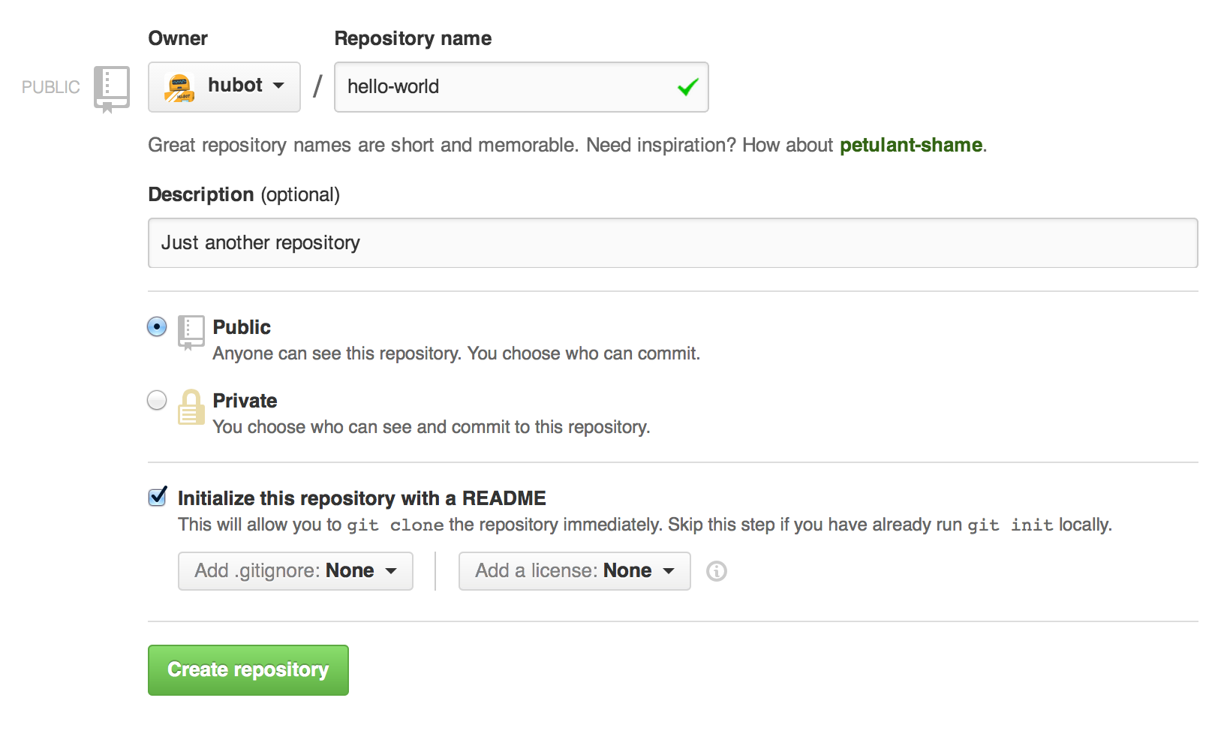

Slide 29
Step 2. Create a Branch
Branching is the way to work on different versions of a repository at one time.
By default your repository has one branch named master which is considered to be the main branch.
We use branches to experiment and make edits before committing them to master.
When you create a branch off the master branch, you’re making a copy, or snapshot, of master as it was at that point in time

Slide 30
To create a new branch
Go to your new repository hello-world.
Click the drop down at the top of the file list that says branch: master.
Type a branch name, readme-edits, into the new branch text box.
Select the blue Create branch box or hit “Enter” on your keyboard.

Slide 31
Step 3. commit changes
On GitHub, saved changes are called commits.
Each commit has an associated commit message, which is a description explaining why a particular change was made.
Commit messages very crucial, so other contributors can understand what you’ve done and why.
First Make change to commit by clicking the pencil Icon.

Slide 32
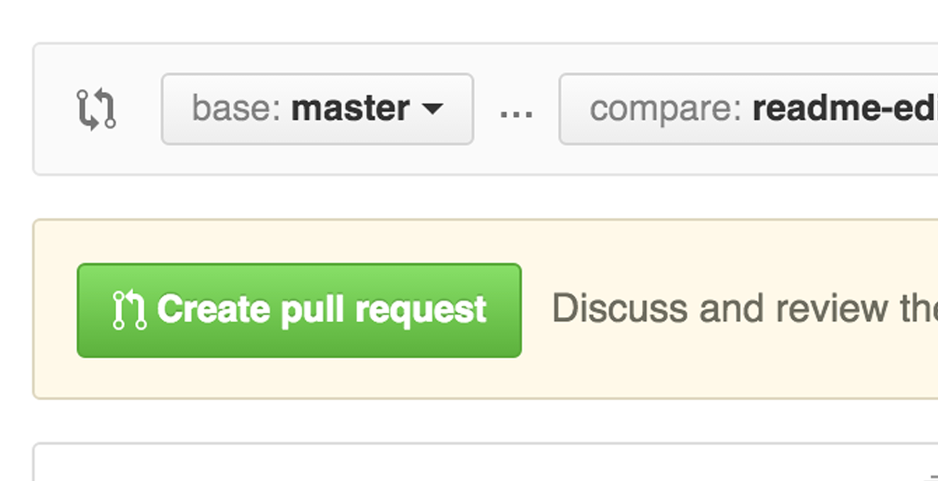
Step 4. Open a Pull Request
Pull Requests are the heart of collaboration on GitHub.
When you open a pull request, you’re proposing your changes and requesting that someone review (Owner) and pull in your contribution and merge them into their branch.
by using GitHub’s @mention system in your pull request message, you can ask for feedback from specific people or teams,
Give your pull request a title and write a brief description of your changes.

Slide 33
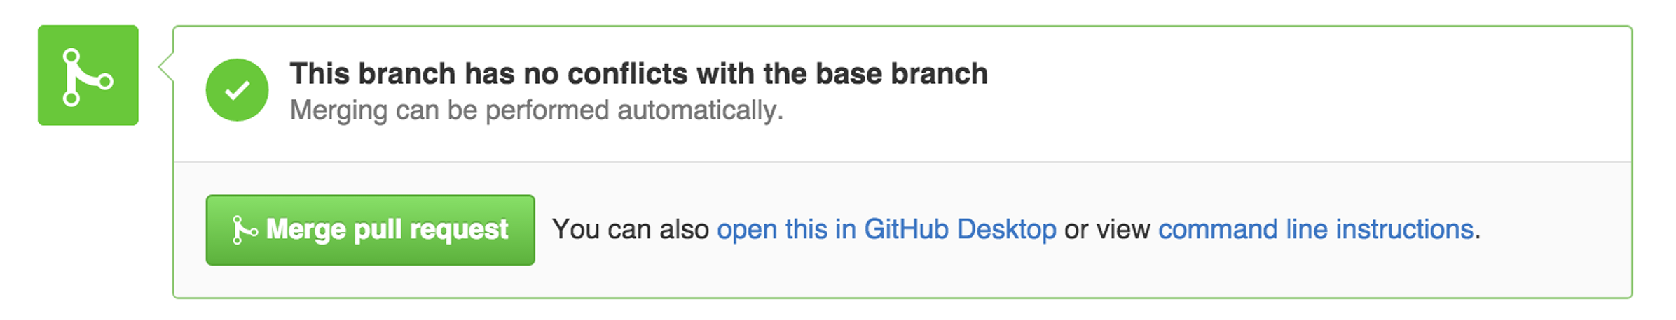
Step 5. Merge your Pull Request
In this final step, it’s time to bring your changes together – merging your changes into master branch.
Click the green Merge pull request button to merge the changes into master.
Go ahead and delete the branch, since its changes have been incorporated, with the Delete branch button in the purple box.

Slide 34
Celebrate!
You are Git and GitHub Expert

